Slide 1
NAS Requirements Services Update for the V&V Summit
Kimberly Gill, ANG-B1 Division Manager
October 10, 2012

Slide 2
Changes in NAS Requirements Management
NAS Requirements Services Division
Where We Are Today
Where We Are Going
Viewed as oversight, a repository, an optional resource
Others “check the box”
“Throw over the fence” collaboration
Unclear role and value
Circumvented
Limited involvement in technical information exchanges between organizations
Strategic involvement and active engagement with programs
Tighter alignment and closer integration with other strategic groups
Clear roles and responsibilities
Provider of enterprise intelligence
Key partner in developing solutions
More sophisticated governance supporting consistency

Slide 3
Requirements Management
Services & Initiatives
ANG-B1
Requirements Services Division
NAS
Program Support
Enterprise Requirements Management
Requirements & Interface Management WG
Integrated Systems Engineering WG
Systems Engineering Manual Update

Slide 4
ANG-B1 Services
Support 30-50 programs annually
through AMS & I2I decision points
Conduct functional analysis
Support the development of requirements
and interface documents
Align Requirements with
Enterprise Architecture views
Support and maintain the
DOORS requirements management tool
NAS
Program
Support

Slide 5
ANG-B1 Services (2)
Maintain NAS requirements
documentation
Update and Align with Enterprise Architecture
Manage requirements linking and
traceability (via DOORS)
Enterprise
Requirements
Management

Slide 6
DOORS
Requirements Management Tool
DOORS requirements capabilities
  Linking – enforces effective systems engineering practices at both program and enterprise levels
  Traceability – enables V&V at any stage
  Scripting – provides customizations for V&V
  Compatibility – interfaces with Enterprise Architecture products for holist systems engineering perspective
Training being developed
Centralizing license management and building consistency of use in an integrated environment

Slide 7
Requirements Management Initiatives
Integrated Systems Engineering WG (ISEWG)
  Co-champion with NAS Enterprise Architect (ANG-B2)
  Developed the NAS Integrated Systems Engineering Framework
Requirements & Interface Management WG (RIMWG)
  Aligned the NAS hierarchy with CM, EA, and NAS Requirements Documents
  Updated the Program Requirements Document template with CPRs (Critical Performance Requirements)
Systems Engineering Manual (SEM) Update
  Held 4 workshops to gain stakeholder feedback
  Publishing an updated SEM in FY2013

Slide 8
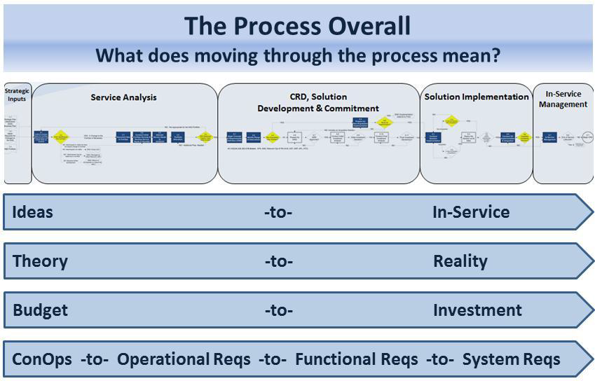
Requirements Management Interfaces with I2I Process
NAS Requirements Database Management Tool
NAS
Operational Requirements
Initial Program Requirements (iPR)
Initial Program Requirements (iPR)
Preliminary Program Requirements (pPR)
Initial Program Requirements (iPR)
Final Program Requirements (fPR)
Initial Program Requirements (iPR)
Initial Program Requirements (iPR)
Initial Program Requirements (iPR)
System Specification Documents
Initial Program Requirements (iPR)
Initial Program Requirements (iPR)
Initial Program Requirements (iPR)
Final Program Requirements (fPR)
Initial Program Requirements (iPR)
Initial Program Requirements (iPR)
Functional Analysis, Interface Documents

Slide 9
Requirements Management V&V in the I2I Process
Requirements Management Process and Artifacts
(Enterprise- & Program-level)
Requirements Database Management
Verification & Validation
Methods

Slide 10
Summary
The NAS Requirements Services Division exists to help you by providing guidance and support in the following areas:
NAS Program Requirements
Requirements Database Management (DOORS)
NAS-RD-20XX Documents
NAS SV-1 diagram and hierarchy (“simplified NAS diagram”)
FAA Systems Engineering Manual (SEM)
Requirements and Interface Management Working Group
Integrated Systems Engineering Working Group
Kimberly Gill 202-385-7214
(Division Manager, NAS Requirements Services, ANG-B1)
Courtney Dudley-Thomas 609-485-6985
(Branch Manager, Requirements Support Services, ANG-B11)

